Slide 1
Application Layer

Slide 2
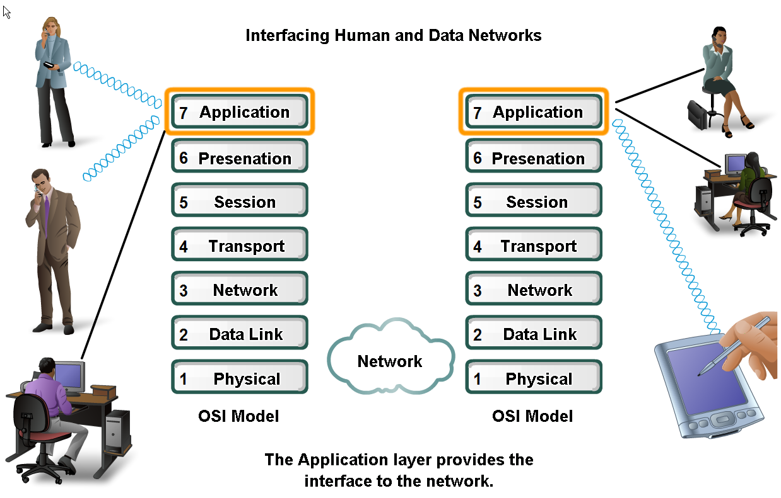
Applications Layer – allows user to interface with the network!

Slide 3
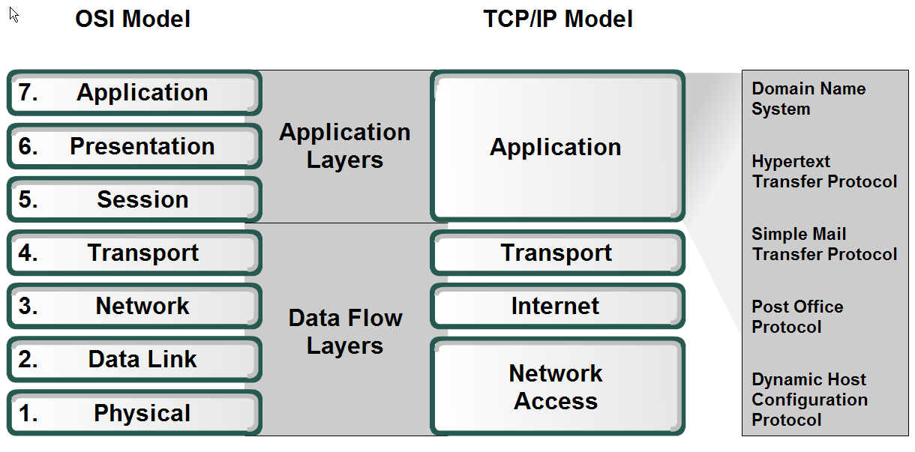
Application Layer – Provides the interface between the applications on either end of the network.

Slide 4
How data requests occur & are filled
Client/server model
  Advantages:
  Centralized administration
  Security is easier to enforce
Application layer services and protocols
Peer-to-peer networking and applications

Slide 5
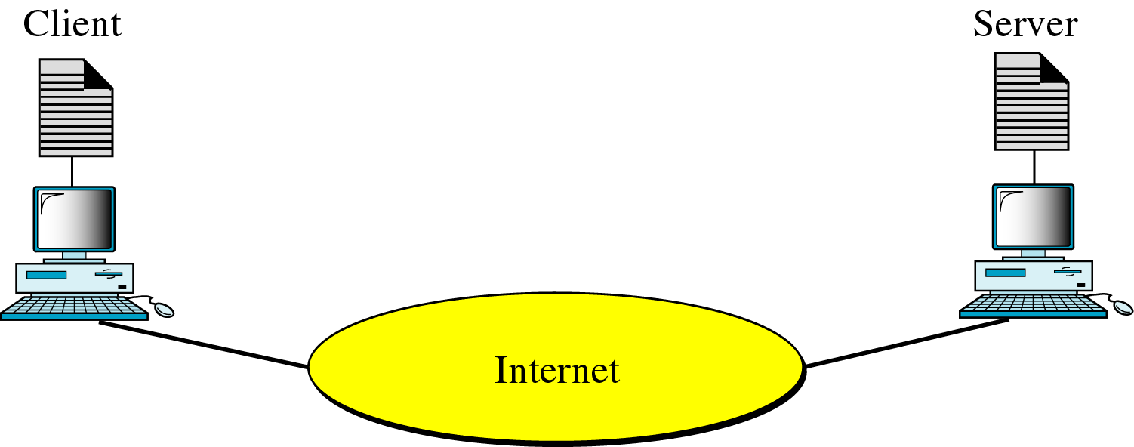
Figure 25-2
Client-Server Model

Slide 6
Client/Server Model
Client – device requesting information (initiates the data exchange)
  Can also UPLOAD data to the servers
Server – device responding to the request
  Relies on support from the lower layer functions to distinguish between services and conversations.
  Server relies on a service called a server daemon – runs in the background and ‘listens’ for requests for that service. It can then exchange messages as appropriate & send requested data.
Examples:
  E-mail Client on an employee computer issues a request to the e-mail server for any unread e-mail. The server responds by sending the e-mail to the client.
  Conversations can originate with either party.

Slide 7
Peer-to-Peer (P2P) Network Model
Two or more computers are connected and are able to share resources without having a dedicated server
Every end device can function as a client or server on a ‘per request’ basis
Resources are decentralized (information can be located anywhere)
Difficult to enforce security and policies
User accounts and access rights have to be set individually on each peer device

Slide 8
P2P Applications
Running applications in hybrid mode allows for a centralized directory of files even though the files themselves may be on multiple machines
Unlike P2P networks, a device can act as both the client and server within the same communication
Each device must provide a user interface and run a background service.
Can be used on P2P networks, client/server networks and across the internet.

Slide 9
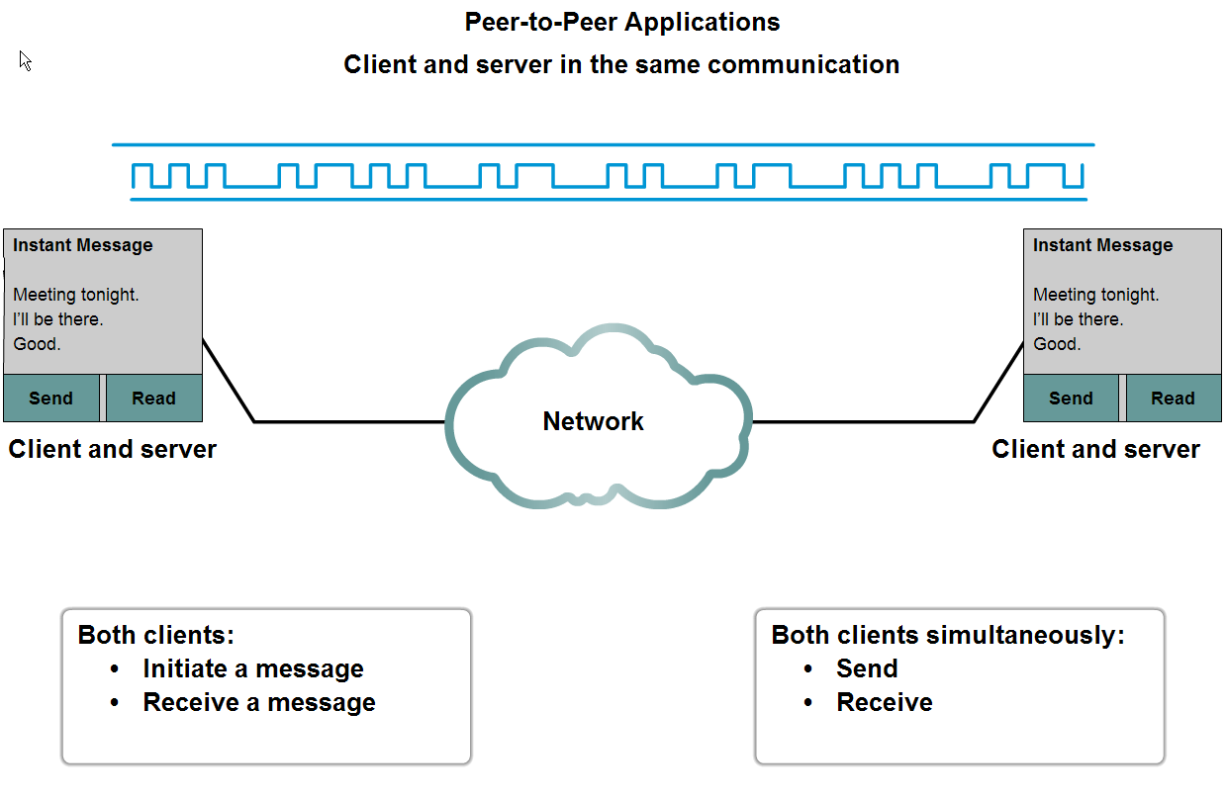
P2P Applications Example

Slide 10
Common Port Numbers
TCP
  FTP – 20-21
  Telnet – 23
  SMTP – 25
  DNS – 53 (Both TCP & UDP)
  HTTP – 80
UDP
  DHCP – 67 & 68
  POP – 110

Slide 11
The TELNET Protocol

Slide 12
TELNET vs. telnet
TELNET is a protocol that provides “a general, bi-directional, eight-bit byte oriented communications facility”.
telnet is a program that supports the TELNET protocol over TCP.
Many application protocols are built upon the TELNET protocol.

Slide 13
The TELNET Protocol
TCP connection
data and control over the same connection.
Network Virtual Terminal
negotiated options

Slide 14
Network Virtual Terminal
intermediate representation of a generic terminal.
provides a standard language for communication of terminal control functions.

Slide 15
Playing with TELNET
You can use the telnet program to play with the TELNET protocol.
telnet is a generic TCP client.
  Sends whatever you type to the TCP socket.
  Prints whatever comes back through the TCP socket
  Useful for testing TCP servers (ASCII based protocols).
Many Unix systems have these servers running (by default):
  echo port 7 discard port 9
  daytime port 13 chargen port 19
TELNET

Slide 16
telnet hostname port
> telnet amele-2.cse.unr.edu 7
Trying 134.197.40.246...
Connected to amele-2.cse.unr.edu (134.197.40.246).
Escape character is '^]'.
Hi mehmet
Hi mehmet
stop it
stop it
^]
telnet> quit
Connection closed.
TELNET

Slide 17
The Domain Name System

Slide 18
A primary server loads all information from the disk file; the secondary server loads all information from the primary server.

Slide 19
DNS In The Internet
Generic Domain
Country Domain
Inverse Domain

Slide 20
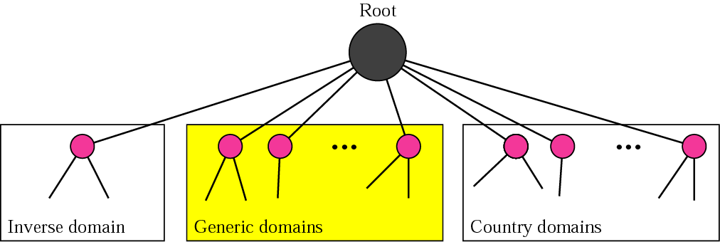
DNS in the Internet

Slide 21
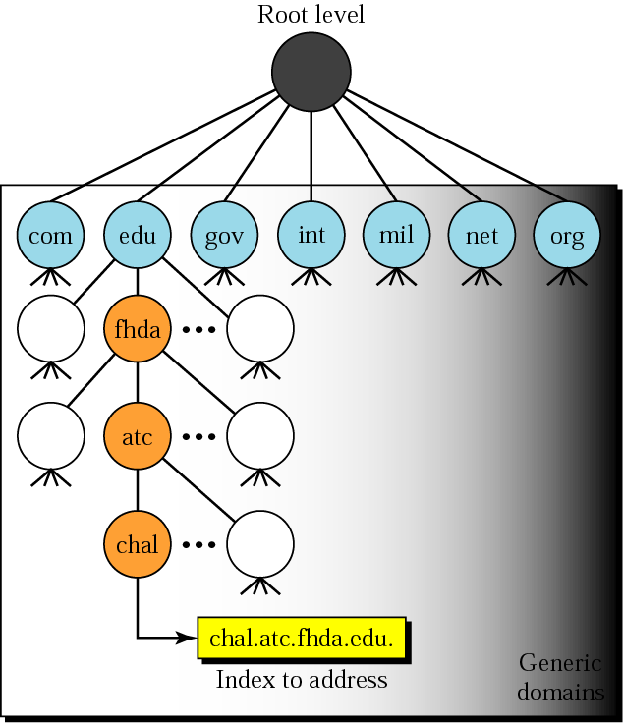
Generic domains

Slide 22
Generic domain labels
Label | Description
com | Commercial organizations
edu | Educational institutions
gov | Government institutions
int | International organizations
mil | Military groups
net | Network support centers
org | Nonprofit organizations

Slide 23
Table 25.2 New generic domain labels
Label | Description
aero | Airlines and aerospace companies
biz | Businesses or firms (similar to com)
coop | Cooperative business organizations
info | Information service providers
museum | Museums and other nonprofit organizations
name | Personal names (individuals)
pro | Professional individual organizations

Slide 24
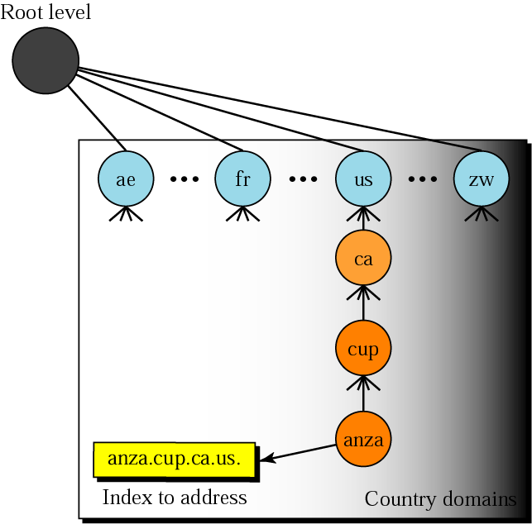
Country domains

Slide 25
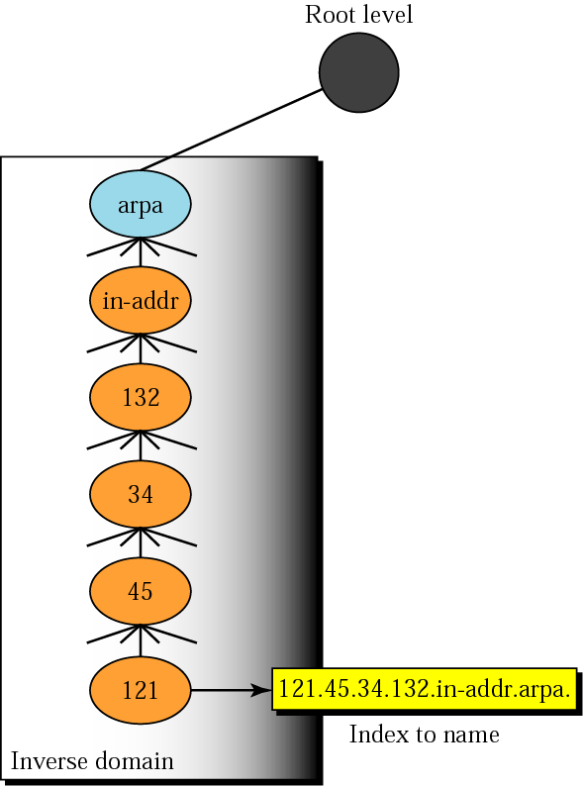
Inverse domain

Slide 26
Hostnames
IP Addresses are great for computers
  IP address includes information used for routing.
IP addresses are tough for humans to remember.
IP addresses are impossible to guess.
  ever guessed at the name of a WWW site?

Slide 27
The Domain Name System
The domain name system is usually used to translate a host name into an IP address .
Domain names comprise a hierarchy so that names are unique, yet easy to remember.

Slide 28
DNS Hierarchy
edu
com
org
jp
rpi
albany

Slide 29
Host name structure
Each host name is made up of a sequence of labels separated by periods.
  Each label can be up to 63 characters
  The total name can be at most 255 characters.
Examples:
  whitehouse.gov
  barney.the.purple.dinosaur.com
  monica.cs.rpi.edu

Slide 30
Domain Name
The domain name for a host is the sequence of labels that lead from the host (leaf node in the naming tree) to the top of the worldwide naming tree.
A domain is a subtree of the worldwide naming tree.

Slide 31
Top level domains
edu, gov, com, net, org, mil, …
Countries each have a top level domain (2 letter domain name).
New top level domains include:
  .aero .biz .coop .info .name .pro

Slide 32
DNS Organization
Distributed Database
  The organization that owns a domain name is responsible for running a DNS server that can provide the mapping between hostnames within the domain to IP addresses.
  So - some machine run by RPI is responsible for everything within the rpi.edu domain.

Slide 33
DNS Distributed Database
There is one primary server for a domain, and typically a number of secondary servers containing replicated databases.
rpi.edu DNS server
rpi.edu
DNS DB
rpi.edu
DNS DB
rpi.edu
DNS DB
rpi.edu
DNS DB
Authoritative
Replicas

Slide 34
DNS Clients
A DNS client is called a resolver.
A call to gethostbyname()is handled by a resolver (typically part of the client).
Most Unix workstations have the file /etc/resolv.conf that contains the local domain and the addresses of DNS servers for that domain.

Slide 35
/etc/resolv.conf
domain rpi.edu
128.113.1.5
128.113.1.3

Slide 36
nslookup
nslookup is an interactive resolver that allows the user to communicate directly with a DNS server.
nslookup is usually available on Unix workstations. (dig and host are also DNS clients).

Slide 37
DNS Servers
Servers handle requests for their domain directly.
Servers handle requests for other domains by contacting remote DNS server(s).
Servers cache external mappings.

Slide 38
Server - Server Communication
If a server is asked to provide the mapping for a host outside it’s domain (and the mapping is not in the server cache):
  The server finds a nameserver for the target domain.
  The server asks the nameserver to provide the host name to IP translation.
To find the right nameserver, use DNS!

Slide 39
DNS Data
DNS databases contain more than just hostname-to-address records:
  Name server records NS
  Hostname aliases CNAME
  Mail Exchangers MX
  Host Information HINFO

Slide 40
The Root DNS Server
The root server needs to know the address of 1st (and many 2nd) level domain nameservers.
edu
com
org
jp
rpi
albany

Slide 41
Server Operation
If a server has no clue about where to find the address for a hostname, ask the root server.
The root server will tell you what nameserver to contact.
A request may get forwarded a few times.

Slide 42
DNS Message Format
HEADER
QUERIES
Response RESOURCE RECORDS
Response AUTHORITY RECORDS
Response ADDITIONAL INFORMATION

Slide 43
DNS Message Header
query identifier
flags
# of questions
# of RRs
# of authority RRs
# of additional RRs
16 bit fields
}
Response

Slide 44
Message Flags
QR: Query=0, Response=1
AA: Authoritative Answer
TC: response truncated (> 512 bytes)
RD: recursion desired
RA: recursion available
rcode: return code

Slide 45
Recursion
A request can indicate that recursion is desired - this tells the server to find out the answer (possibly by contacting other servers).
If recursion is not requested - the response may be a list of other name servers to contact.

Slide 46
Question Format
Name: domain name (or IP address)
Query type (A, NS, MX, …)
Query class (1 for IP)

Slide 47
Response Resource Record
Domain Name
Response type
Class (IP)
Time to live (in seconds)
Length of resource data
Resource data

Slide 48
Resource Records
Each name server maintains a collection of resource records
    (Name, Value, Type, Class, TTL)
  Each record is a translation based on type
  Name/Value: not necessarily host names to IP addresses
Type (some examples)
  A: Name = full domain name, Value = IP address
  NS: Value gives domain name for host running name server that knows how to resolve names within specified domain.
  CNAME: Value gives canonical name for particle host; used to define aliases.
  MX: Value gives domain name for host running mail server that accepts messages for specified domain.
Class: allow other entities (other than NIC) to define types
  IN is what is used by the Internet
TTL: how long the resource record is valid

Slide 49
DNS Resource Record
The resource record will be in this format
Domain_name time_to_live class type value
Domain_name - it tells the domain name
time_to_live - the existance of record for 1day/hr/min
Class – it is generally IN(internet information)
Type – it denotes a Host/name server/mail server etc..
Value – it can be a number/domain name/Ascii string
Eg:
www.yahoo.com 86400 IN NS 130.37.16.112
www.gitam.edu 86400 IN MX 192.168.34.56
Notes:
Use the same name for mail server and web server
Ttl – how long the RR can be kept in the cache

Slide 50
UDP & TCP
Both UDP and TCP are used:
  TCP for transfers of entire database to secondary servers (replication).
  UDP for lookups
  If more than 512 bytes in response - requestor resubmits request using TCP.

Slide 51
Name to Address Conversion
There is a library of functions that act as DNS client (resolver).
  you don’t need to write DNS client code to use DNS!
With some OSs you need to explicitly link with the DNS resolver library:
  -lnsl (nsl is “Name Server Library”)

Slide 52
FTP - File Transfer Protocol
TFTP – Trivial FTP

Slide 53
Overview
File Transfer Protocol (RFC 959)
  Why FTP?
  FTP’s connections
  FTP in action
  FTP commands/responses
Trivial File Transfer Protocol (RFC 1350)
  TFTP and TFTP’s message formats
  FTP and TFTP compared

Slide 54
Why do we need a FTP Service?
Purpose: To Transfer files between two computers
Goals of FTP Service
  Promote sharing of files (programs and/or data)
  Encourage indirect/implicit use of remote computers
  Shield users from variations in file storage among hosts
  Transfer data reliably and efficiently

Slide 55




Problems of File Transfer
At first, file transfer may seem simple
Heterogeneous systems use different:
  Operating Systems
  Character Sets
  Naming Conventions
  Directory Structures
  File Structures and Formats
FTP need to address and resolve these problems

Slide 56


FTP’s Connections
2
* Persistent command
and reply connection
* Insulates users from “raw”
FTP commands
client
Non-persistent data
connection
Server is listening on port 21
for connection requests
* Routes “raw” FTP commands
* Receives server’s replies
*Server uses port 20
for data connections
User
Interface
server
User
Protocol
Interpreter
Control
Connection
Server
Protocol
Interpreter
21
User
Data Transfer
Function
Data
Connection
Server
Data Transfer
Function
20

Slide 57
FTP’s Connections – Establishment
2
ftp> open strauss.udel.edu
Connected to strauss.udel.edu
220 strauss FTP server ready.
530 Please login with USER and PASS
client
331 Password req for haggerty.
Password:
User
Interface
230 User haggerty logged in.
ftp>
USER haggerty
PASS mypass
server
User
Protocol
Interpreter
Control
Connection
Server
Protocol
Interpreter
User
Data Transfer
Function
Data
Connection
Server
Data Transfer
Function

Slide 58

FTP’s Connections
Data Transfer
2
client
ls client.txt
-rw-r--r-- haggerty client.txt
User
Interface
226 Closing Data Connection
200 Port Command Sucessful
LIST client.txt
PORT 192,168,100,173,19,137
150 Data Connection will be open shortly
server
User
Protocol
Interpreter
User
Protocol
Interpreter
Server
Protocol
Interpreter
Control
Connection
Server
Protocol
Interpreter
Passive open on
Port 5001
User
Data Transfer
Function
Data
Connection
Server
Data Transfer
Function
Establish Data Connection

Slide 59
FTP’s Connections – Connection Closing
2
bye
client
User
Interface
221 Service Closing
QUIT
server
User
Protocol
Interpreter
Control
Connection
Server
Protocol
Interpreter
User
Data Transfer
Function
Data
Connection
Server
Data Transfer
Function

Slide 60
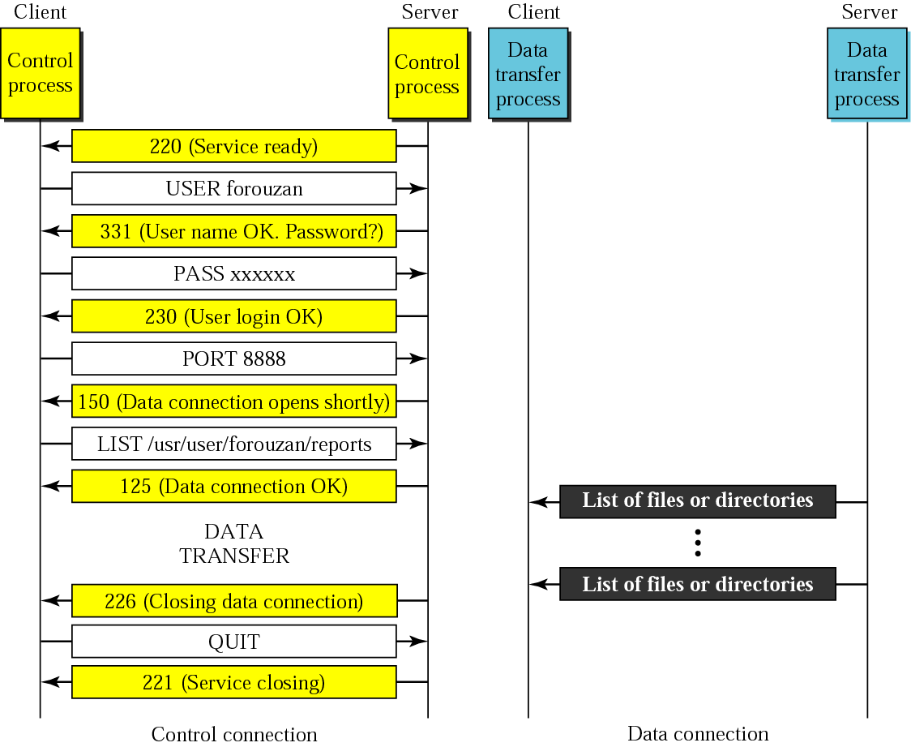
FTP Connections

Slide 61
FTP Connection
Client
Server
ftp> open server
SYN
SYN|ACK
ACK
220 Service Ready
ACK
ftp> USER haggerty
ACK
331 User OK,password?
ACK
ftp> PASS mypass
ACK
230 User login OK
ACK

Slide 62
FTP Data Transfer
Client
Server
PORT 192,168,0,173,19,137
ACK
200 Command Successful
NLST client.txt
ACK
SYN
SYN-ACK
ACK
150 Data Connection will be open shortly
ACK
NAME LIST
FIN
Control connection
FIN-ACK
Data Connection
ACK
226 Closing Data Connection
ACK

Slide 63
FTP Client Commands (issued by user interface)
Command | Description
get filename | Retrieve file from server
mget filename* | Retrieve multiple files from server*
put filename | Copy local file to server
mput filename* | Copy multiple local files to server*
open server | Begin login to server
bye / close / exit | Logoff server
ls / dir | List files in current remote dir on server
lcd | Change local directory
cd | Change remote directory
rhelp / remotehelp | Lists commands the server accepts
* Sent to server as multiple command by User Protocol Interpreter

Slide 64
Example FTP Responses
120 Service will be ready shortly
200 Command OK
230 User login OK
331 User name OK; password is needed
421 Service not available
530 User not logged in
552 Requested action aborted; exceeded storage allocation

Slide 65
Summary of FTP connections
FTP has 2 connections
  Control (persistent connection)
    Server issues a passive open on well-known 21
    Client uses an ephemeral port to issue active open
    Server ultimately closes control connection
  Data (ephemeral connection)
    Client issues passive open on an ephemeral port
    Client sends this port to server via PORT command
    Server receives the port number and issues active open using its well-known 20 to the received ephemeral port

Slide 66

Note:
TFTP uses the services of UDP on the well-known port 69.
TCP/IP Protocol Suite

Slide 67
Trivial FTP (TFTP)
Used only to read and write files from/to a remote server
  Cannot list directories
Useful for bootstrapping diskless systems
  Workstations
  X terminals
Simple and small:
  5 message formats
  Runs on UDP
  Designed to fit in ROM
  Uses a “stop and wait” protocol
  NO BUILT IN SECURITY FEATURES (login)
Notes:
TFTP uses the services of UDP on well known port 69.

Slide 68
FTP vs. TFTP
FTP provides (minimal) security through login procedure
TFTP has NO login procedure
FTP Provides a reliable service through its use of TCP
TFTP must handle its own retransmissions since it uses UDP
FTP uses two connections
TFTP uses one connection (stop and wait)
FTP provides many commands
TFTP can only read and write files
Slide from William Boyer boyer@cis.udel.edu

Slide 69

Hyper Text Transfer Protocol

Slide 70

HTTP uses the services of
TCP on well-known port 80.

Slide 71
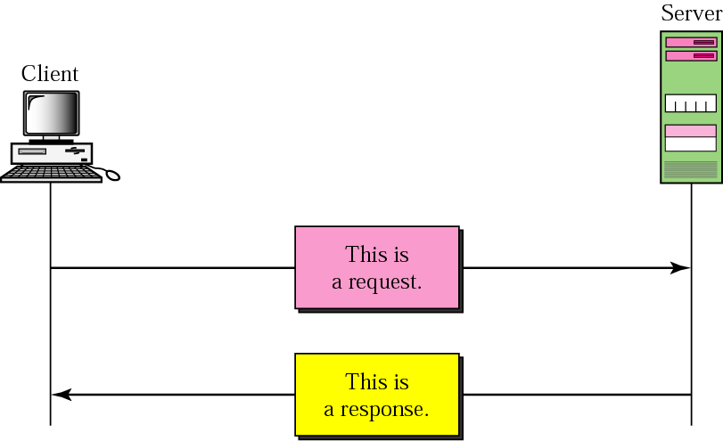
Figure 24-1
HTTP transaction

Slide 72
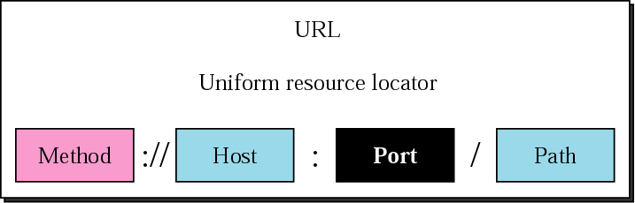
Figure 24-5
URL

Slide 73
Contents
Main ingredients of the Web
  URL, HTML, and HTTP
Key properties of HTTP
  Request-response, stateless, and resource meta-data
Web components
  Clients, proxies, and servers
  Caching vs. replication
Interaction with underlying network protocols
  DNS and TCP
  TCP performance for short transfers
  Parallel connections, persistent connections, pipelining

Slide 74
Web History
Before the 1970s-1980s
  Internet used mainly by researchers and academics
  Log in remote machines, transfer files, exchange e-mail
Late 1980s and early 1990s
  Initial proposal for the Web by Berners-Lee in 1989
  Competing systems for searching/accessing documents
    Gopher, Archie, WAIS (Wide Area Information Servers), …
    All eventually subsumed by the World Wide Web
Growth of the Web in the 1990s
  1991: first Web browser and server
  1993: first version of Mosaic browser

Slide 75
Enablers for Success of the Web
Internet growth and commercialization
  1988: ARPANET gradually replaced by the NSFNET
  Early 1990s: NSFNET begins to allow commercial traffic
Personal computer
  1980s: Home computers with graphical user interfaces
  1990s: Power of PCs increases, and cost decreases
Hypertext
  1945: Vannevar Bush’s “As We May Think”
  1960s: Hypertext proposed, and the mouse invented
  1980s: Proposals for global hypertext publishing systems

Slide 76
Main Components: URL
Uniform Resource Identifier (URI)
  Denotes a resource independent of its location or value
  A pointer to a “black box” that accepts request methods
Formatted string
  Protocol for communicating with server (e.g., http)
  Name of the server (e.g., www.foo.com)
  Name of the resource (e.g., coolpic.gif)
Name (URN), Locator (URL), and Identifier (URI)
  URN: globally unique name, like an ISBN # for a book
  URI: identifier representing the contents of the book
  URL: location of the book

Slide 77
Main Components: HTML
HyperText Markup Language (HTML)
  Representation of hyptertext documents in ASCII format
  Format text, reference images, embed hyperlinks
  Interpreted by Web browsers when rendering a page
Straight-forward and easy to learn
  Simplest HTML document is a plain text file
    Easy to add formatting, references, bullets, etc.
  Automatically generated by authoring programs
    Tools to aid users in creating HTML files
Web page
  Base HTML file referenced objects (e.g., images)
  Each object has its own URL

Slide 78
Main Components: HTTP
HyperText Transfer Protocol (HTTP)
  Client-server protocol for transferring resources
  Client sends request and server sends response
Important properties of HTTP
  Request-response protocol
  Reliance on a global URI
  Resource metadata
  Statelessness
  ASCII format
telnet www.cs.princeton.edu 80
GET /~jrex/ HTTP/1.1
Host: www.cs.princeton.edu

Slide 79
Example: HyperText Transfer Protocol
GET /courses/archive/spring06/cos461/ HTTP/1.1
Host: www.cs.princeton.edu
User-Agent: Mozilla/4.03
<CRLF>
Request
HTTP/1.1 200 OK
Date: Mon, 6 Feb 2006 13:09:03 GMT
Server: Netscape-Enterprise/3.5.1
Last-Modified: Mon, 6 Feb 2006 11:12:23 GMT
Content-Length: 21
<CRLF>
Site under construction
Response

Slide 80


HTTP: Request-Response Protocol
Client program
  Running on end host
  Requests service
  E.g., Web browser
Server program
  Running on end host
  Provides service
  E.g., Web server
GET /index.html
“Site under construction”

Slide 81
HTTP Request Message
Request message sent by a client
  Request line: method, resource, and protocol version
  Request headers: provide information or modify request
  Body: optional data (e.g., to “POST” data to the server)
request line
(GET, POST,
HEAD commands)
GET /somedir/page.html HTTP/1.1
Host: www.someschool.edu
User-agent: Mozilla/4.0
Connection: close
Accept-language:fr
(extra carriage return, line feed)
header
lines
Carriage return,
line feed
indicates end
of message

Slide 82
Example: Conditional GET Request
Fetch resource only if it has changed at the server
Server avoids wasting resources to send again
  Server inspects the “last modified” time of the resource
  … and compares to the “if-modified-since” time
  Returns “304 Not Modified” if resource has not changed
  …. or a “200 OK” with the latest version otherwise
GET /courses/archive/spring06/cos461/ HTTP/1.1
Host: www.cs.princeton.edu
User-Agent: Mozilla/4.03
If-Modified-Since: Mon, 6 Feb 2006 11:12:23 GMT
<CRLF>

Slide 83
HTTP Response Message
Response message sent by a server
  Status line: protocol version, status code, status phrase
  Response headers: provide information
  Body: optional data
status line
(protocol
status code
status phrase)
HTTP/1.1 200 OK
Connection close
Date: Thu, 06 Aug 1998 12:00:15 GMT
Server: Apache/1.3.0 (Unix)
Last-Modified: Mon, 22 Jun 1998 …...
Content-Length: 6821
Content-Type: text/html
data data data data data ...
header
lines
data, e.g.,
requested
HTML file

Slide 84
Request Methods and Response Codes
Request methods include
  GET: return current value of resource, run program, …
  HEAD: return the meta-data associated with a resource
  POST: update a resource, provide input to a program, …
Response code classes
  1xx: informational (e.g., “100 Continue”)
  2xx: success (e.g., “200 OK”)
  3xx: redirection (e.g., “304 Not Modified”)
  4xx: client error (e.g., “404 Not Found”)
  5xx: server error (e.g., “503 Service Unavailable”)
Note similarities to File Transfer Protocol (FTP)

Slide 85
HTTP Resource Meta-Data
Meta-data
  Information relating to a resource
  … but not part of the resource itself
Example meta-data
  Size of a resource
  Type of the content
  Last modification time
Concept borrowed from e-mail protocols
  Multipurpose Internet Mail Extensions (MIME)
  Data format classification (e.g., Content-Type: text/html)
  Enables browsers to automatically launch a viewer

Slide 86
Stateless Protocol
Stateless protocol
  Each request-response exchange treated independently
  Clients and servers not required to retain state
Statelessness to improve scalability
  Avoid need for the server to retain info across requests
  Enable the server to handle a higher rate of requests
However, some applications need state
  To uniquely identify the user or store temporary info
  E.g., personalize a Web page, compute profiles or access statistics by user, keep a shopping cart, etc.
  Lead to the introduction of “cookies” in the mid 1990s

Slide 87
Cookies
Cookie
  Small state stored by client on behalf of server
  Included in future requests to the server
Request
Response
Set-Cookie: XYZ
Request
Cookie: XYZ

Slide 88
Cookies Examples
client
server
Cookie file
usual http request msg
server
creates ID
1678 for user
entry in backend
database
ebay: 8734
usual http response +
Set-cookie: 1678
Cookie file
usual http request msg
cookie: 1678
amazon: 1678
ebay: 8734
cookie-
specific
action
access
usual http response msg
one week later:
access
Cookie file
usual http request msg
cookie: 1678
cookie-
spectific
action
amazon: 1678
ebay: 8734
usual http response msg

Slide 89
Web Components
Clients
  Send requests and receive responses
  Browsers, spiders, and agents
Servers
  Receive requests and send responses
  Store or generate the responses
Proxies
  Act as a server for the client, and a client to the server
  Perform extra functions such as anonymization, logging, transcoding, blocking of access, caching, etc.

Slide 90
Web Browser
Generating HTTP requests
  User types URL, clicks a hyperlink, or selects bookmark
  User clicks “reload”, or “submit” on a Web page
  Automatic downloading of embedded images
Layout of response
  Parsing HTML and rendering the Web page
  Invoking helper applications (e.g., Acrobat, PowerPoint)
Maintaining a cache
  Storing recently-viewed objects
  Checking that cached objects are fresh

Slide 91
Typical Web Transaction
User clicks on a hyperlink
  http://www.cnn.com/index.html
Browser learns the IP address of the server
  Invokes gethostbyname(www.cnn.com)
  And gets a return value of 64.236.16.20
Browser establishes a TCP connection
  Selects an ephemeral port for its end of the connection
  Contacts 64.236.16.20 on port 80
Browser sends the HTTP request
  “GET /index.html HTTP/1.1
  Host: www.cnn.com”

Slide 92
Typical Web Transaction (Continued)
Browser parses the HTTP response message
  Extract the URL for each embedded image
  Create new TCP connections and send new requests
  Render the Web page, including the images
Opportunities for caching in the browser
  HTML file
  Each embedded image
  IP address of the Web site

Slide 93
Web Server
Web site vs. Web server
  Web site: collections of Web pages associated with a particular host name
  Web server: program that satisfies client requests for Web resources
Handling a client request
  Accept the TCP connection
  Read and parse the HTTP request message
  Translate the URL to a filename
  Determine whether the request is authorized
  Generate and transmit the response

Slide 94
Web Server: Generating a Response
Returning a file
  URL corresponds to a file (e.g., /www/index.html)
  … and the server returns the file as the response
  … along with the HTTP response header
Returning meta-data with no body
  Example: client requests object “if-modified-since”
  Server checks if the object has been modified
  … and simply returns a “HTTP/1.1 304 Not Modified”
Dynamically-generated responses
  URL corresponds to a program the server needs to run
  Server runs the program and sends the output to client

Slide 95
Hosting: Multiple Sites Per Machine
Multiple Web sites on a single machine
  Hosting company runs the Web server on behalf of multiple sites (e.g., www.foo.com and www.bar.com)
Problem: returning the correct content
  www.foo.com/index.html vs. www.bar.com/index.html
  How to differentiate when both are on same machine?
Solution #1: multiple servers on the same machine
  Run multiple Web servers on the machine
  Have a separate IP address for each server
Solution #2: include site name in the HTTP request
  Run a single Web server with a single IP address
  … and include “Host” header (e.g., “Host: www.foo.com”)

Slide 96
Hosting: Multiple Machines Per Site
Replicating a popular Web site
  Running on multiple machines to handle the load
  … and to place content closer to the clients
Problem: directing client to a particular replica
  To balance load across the server replicas
  To pair clients with nearby servers
Solution #1: manual selection by clients
  Each replica has its own site name
  A Web page lists the replicas (e.g., by name, location)
  … and asks clients to click on a hyperlink to pick

Slide 97
Hosting: Multiple Machines Per Site
Solution #2: single IP address, multiple machines
  Same name and IP address for all of the replicas
  Run multiple machines behind a single IP address
  Ensure all packets from a single
  TCP connection go to the same replica
Load Balancer
64.236.16.20

Slide 98

Hosting: Multiple Machines Per Site
Solution #3: multiple addresses, multiple machines
  Same name but different addresses for all of the replicas
  Configure DNS server to return different addresses
12.1.1.1
64.236.16.20
Internet
103.72.54.131

Slide 99
Caching vs. Replication
Motivations for moving content close to users
  Reduce latency for the user
  Reduce load on the network and the server
  Reduce cost for transferring data on the network
Caching
  Replicating the content “on demand” after a request
  Storing the response message locally for future use
  May need to verify if the response has changed
  … and some responses are not cacheable
Replication
  Planned replication of the content in multiple locations
  Updating of resources is handled outside of HTTP
  Can replicate scripts that create dynamic responses

Slide 100
Caching vs. Replication (Continued)
Caching initially viewed as very important in HTTP
  Many additions to HTTP to support caching
  … and, in particular, cache validation
Deployment of caching proxies in the 1990s
  Service providers and enterprises deployed proxies
  … to cache content across a community of users
  Though, sometimes the gains weren’t very dramatic
Then, content distribution networks emerged
  Companies (like Akamai) that replicate Web sites
  Host all (or part) of a Web site for a content provider
  Place replicas all over the world on many machines

Slide 101
TCP Interaction: Multiple Transfers
Most Web pages have multiple objects
  E.g., HTML file and multiple embedded images
Serializing the transfers is not efficient
  Sending the images one at a time introduces delay
  Cannot start retrieving second images until first arrives
Parallel connections
  Browser opens multiple TCP connections (e.g., 4)
  … and retrieves a single image on each connection
Performance trade-offs
  Multiple downloads sharing the same network links
  Unfairness to other traffic traversing the links

Slide 102

TCP Interaction: Short Transfers
Most HTTP transfers are short
  Very small request message (e.g., a few hundred bytes)
  Small response message
  (e.g., a few kilobytes)
TCP overhead may be big
  Three-way handshake to establish connection
  Four-way handshake to tear down the connection
initiate TCP
connection
RTT
request
file
time to
transmit
file
RTT
file
received
time
time

Slide 103
TCP Interaction: Short Transfers
Round-trip time estimation
  Very large at the start of a connection (e.g., 3 seconds)
  Leads to latency in detecting lost packets
Congestion window
  Small value at beginning of connection (e.g., 1 MSS)
  May not reach a high value before transfer is done
Timeout vs. triple-duplicate ACK
  Two main ways of detecting packet loss
  Timeout is slow, and triple-duplicate ACK is fast
  However, triple-dup-ACK requires many packets in flight
  … which doesn’t happen for very short transfers

Slide 104
TCP Interaction: Persistent Connections
Handle multiple transfers per connection
  Maintain the TCP connection across multiple requests
  Either the client or server can tear down the connection
  Added to HTTP after the Web became very popular
Performance advantages
  Avoid overhead of connection set-up and tear-down
  Allow TCP to learn a more accurate RTT estimate
  Allow the TCP congestion window to increase
Further enhancement: pipelining
  Send multiple requests one after the other
  … before receiving the first response

Slide 105
Conclusions
Key ideas underlying the Web
  Uniform Resource Identifier (URI)
  HyperText Markup Language (HTML)
  HyperText Transfer Protocol (HTTP)
  Browser helper applications based on content type
Main Web components
  Clients, proxies, and servers
Dependence on underlying Internet protocols
  DNS and TCP
Next week: other application-layer protocols
  E-mail, peer-to-peer file sharing, Voice-over-IP

Slide 106
POP3

Slide 107
POP3
Stands for Post Office Protocol – Version 3
RFC in 1993
POP3 “is intended to permit a workstation to dynamically access a maildrop on a server host in a useful fashion. Usually, this means that the POP3 protocol is used to allow a workstation to retrieve mail that the server is holding for it.“

Slide 108
POP3
Doesn’t provide extensive mail operations on the server
Normally mail is downloaded, then deleted
Deletion doesn’t really occur until QUIT
Uses port 110

Slide 109
Minimal POP3 Commands
USER name – user’s name
PASS string – user’s password
QUIT – quits, and updates the mailbox
STAT – status
LIST [msg] – lists the mail messages (#’s only)
RETR msg – retrieves a mail message
DELE msg – deletes a message
NOOP – No operation
RSET – resets the mail to its original state

Slide 110
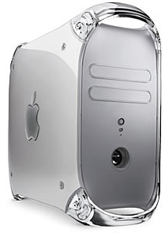
Example POP3 Transaction
Server

Slide 111

Establish the Socket
Primary
Thread
Socket (101)
Primary
Thread
Server
Client

Slide 112
Server is OK
+OK POP3 server ready
Primary
Thread
Socket (101)
Primary
Thread
Server
Client

Slide 113
Establish the Socket
USER bob
Primary
Thread
Socket (101)
Primary
Thread
Server
Client

Slide 114
This user is OK
+OK
Primary
Thread
Socket (101)
Primary
Thread
Server
Client

Slide 115
Send the Password
PASS ITSD4304
Primary
Thread
Socket (101)
Primary
Thread
Server
Client

Slide 116
The Password is OK
+OK
Primary
Thread
Socket (101)
Primary
Thread
Server
Client

Slide 117
Ask how the Server is Feeling…
STAT
Primary
Thread
Socket (101)
Primary
Thread
Server
Client

Slide 118
I’m Fine, Thanks!
+OK 2 320
Primary
Thread
Socket (101)
Primary
Thread
Server
Client

Slide 119
Got Any Mail?
LIST
Primary
Thread
Socket (101)
Primary
Thread
Server
Client

Slide 120
Yup…
+OK 2 messages (320 octets)
Primary
Thread
Socket (101)
Primary
Thread
Server
Client

Slide 121
Message One
1 120
Primary
Thread
Socket (101)
Primary
Thread
Server
Client

Slide 122
Message Two
2 200
Primary
Thread
Socket (101)
Primary
Thread
Server
Client

Slide 123
End
.
Primary
Thread
Socket (101)
Primary
Thread
Server
Client

Slide 124
Get Message One
RETR 1
Primary
Thread
Socket (101)
Primary
Thread
Server
Client

Slide 125
Message One Coming!
+OK 120 octets
Primary
Thread
Socket (101)
Primary
Thread
Server
Client

Slide 126
Message One Coming!
<the POP3 server sends message 1>
Primary
Thread
Socket (101)
Primary
Thread
Server
Client

Slide 127
End of Message 1
.
Primary
Thread
Socket (101)
Primary
Thread
Server
Client

Slide 128
Get Message One
DELE 1
Primary
Thread
Socket (101)
Primary
Thread
Server
Client

Slide 129
Message 1 Gone!
+OK message 1 deleted
Primary
Thread
Socket (101)
Primary
Thread
Server
Client
Note: it’s not really gone…

Slide 130
Get Message One
QUIT
Primary
Thread
Socket (101)
Primary
Thread
Server
Client

Slide 131
QUIT – Commits/Updates
+OK bob POP3 server signing off
Primary
Thread
Socket (101)
Primary
Thread
Server
Client
Note: now it’s gone

Slide 132
Socket Disposed
Primary
Thread
Primary
Thread
Server
Client

Slide 133
IMAP
(Internet Message Access Protocol)

Slide 134
Content
about imap
procedure of the imap protocol
interaction between client and server
flags message attributes
different states of an imap session
  state diagram
commands
example of an imap session

Slide 135
About IMAP
Internet message access protocol
Stands for accessing electronic mail that are kept on a server
access messages from more than one computer
More than one user
Imap protocol based on a TCP connection (port 143)
No functionality to send messages (realized with SMTP)

Slide 136
Procedure of the imap protocol
All emails are kept on a mail server
Functionality:
  Treat as local directory
  work directly on server
  copy
  delete
  different folders
download message headers and later on the full messages

Slide 137
Procedure of the imap protocol [2]
communication procedure:
  Connection initialization
  Welcome of the server
  Interaction between client and server
  Connection closed

Slide 138
Interaction between client and server
Client sends data - server receives:
  client-command begins with alphanumeric string (‘tag’) e.g. A001 which is created for every new command
  then the command with corresponding arguments follows
Server sends data – client receives
  Server receives and works with the command
  Returns the same tag with a state (OK/NO/BAD)
  Additional information begin with ‘*’ (untagged)
  Untagged information can be sent at every time

Slide 139
Different states of an imap session
Most commands are only valid in special states (otherwise: protocol error)
4 states (initialization is not an own state)
  Non-Authenticated
  Authenticated
  Selected
  Logout, Closed

Slide 140
State diagram
Initialization
Connect
Reject con.
Logout
Non-Authenticated
Preauth
Logout, Close
Login
Logout
Authenticated
Select
Close
Logout
Selected

Slide 141
Flags message attributes
List of token associated with the message that is sent by the server
A flag can be permanent or session-only
types:
  System flag:
    flag name that is pre-defined in the imap specification
    All system flags begin with ‘\’
  Keywords:
    A keyword is defined by the server implementation
    Keywords do not begin with ‘\’

Slide 142
Flags Message Attributes [2]
\Seen (Message has been read)
\Answered (Message has been answered)
\Flagged (Message is "flagged" for urgent/special attention)
\Deleted (Message is "deleted" for removal by later EXPUNGE)
\Draft (Message has not completed composition (marked as a draft))
\Recent (Message is "recently" arrived in this mailbox. This session is the first session to have been notified about this message)

Slide 143
commands
LOGIN username password
SELECT mailbox-name
CREATE new-mailbox-name
DELETE mailbox-name
RENAME old-name new-name
AUTHENTICATE
CLOSE
SEARCH
COPY

Slide 144
imap session
S: * OK IMAP4rev1 Service Ready
C: a001 login TIM timmy
S: a001 OK LOGIN completed
C: a002 select inbox
S: * 18 EXISTS
S: * FLAGS(\Answered\Flagged\Deleted\Seen\Draft)
S: * 2 RECENT
S: * OK [UNSEEN 17] Message 17 is the first unseen message
S: * OK [UIDVALIDITY 3857529045] UIDs valid
S: a002 OK [READ-WRITE] SELECT completed
C: a003 fetch 12 body[header]
S: * 12 FETCH (BODY[HEADER] {350}
S: Date: Wed, 19 May 2003 02:23:25 -0700 (PDT)
S: From: christiane <christiane@schmidt.de>
S: Subject: weekend planning

Slide 145
imap session [2]
S: To: steffen <steffen@grunwald.de>
S: cc: steffen <steffen@diehl.de>
S: Message-Id: <B27397-0100000@TIM01.de>
S: MIME-Version: 1.0
S: Content-Type: TEXT/PLAIN; CHARSET=US-ASCII
S:
S: )
S: a003 OK FETCH completed
C: a004 store 12 +flags \deleted
S: * 12 FETCH (FLAGS (\Seen \Deleted))
S: a004 OK +FLAGS completed
C: a005 logout
S: * BYE IMAP4rev1 server terminating connection
S: a005 OK LOGOUT completed

Slide 146
Simple Mail Transfer Protocol
Notes:
http://www.spamfilterreview.com/spam-statistics.html, stats about spam

Slide 147
Overview
Introduction
Message Breakdown
Sending Messages
Extensions
Retrieving mail (Mailbox Protocols)
Examples

Slide 148
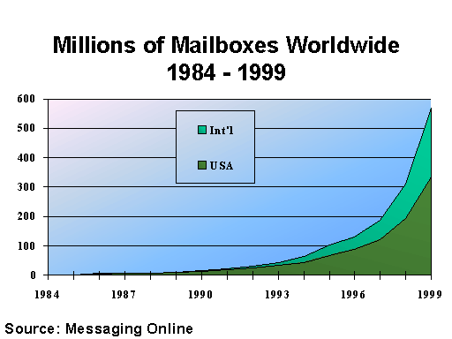
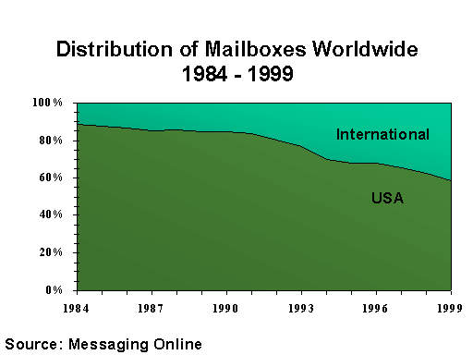
Email Statistics
Email Statistics (2004):
31 billion emails sent daily, expected to double by 2006
Email generates about one billion Gigabytes of new “information” per year
Spam accounts for about 40% of all email traffic
http://www.spamfilterreview.com

Slide 149
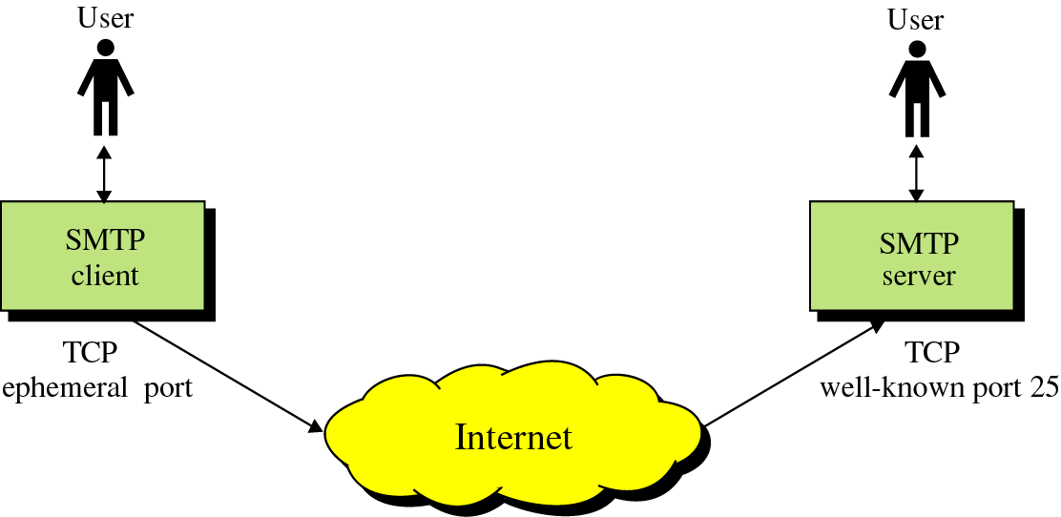
SMTP
Protocol originated in 1982 (RFC821, Jon Postel)
Standard message format (RFC822,2822, D. Crocker)
Goal: To transfer mail reliably and efficiently

Slide 150
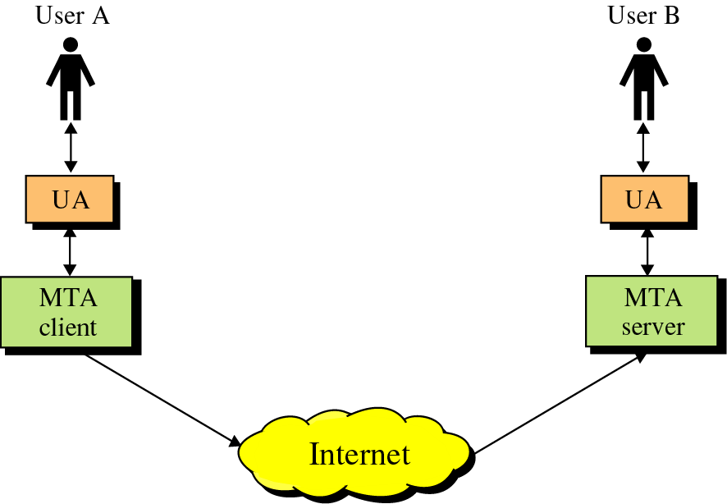
SMTP
SMTP clients and servers have two main components
  User Agents – Prepares the message, encloses it in an envelope. (ex. Thunderbird, Eudora)
  Mail Transfer Agent – Transfers the mail across the internet (ex. Sendmail, Exim)
  Analogous to the postal system in many ways
User Agents
Mail Transfer Agents

Slide 151
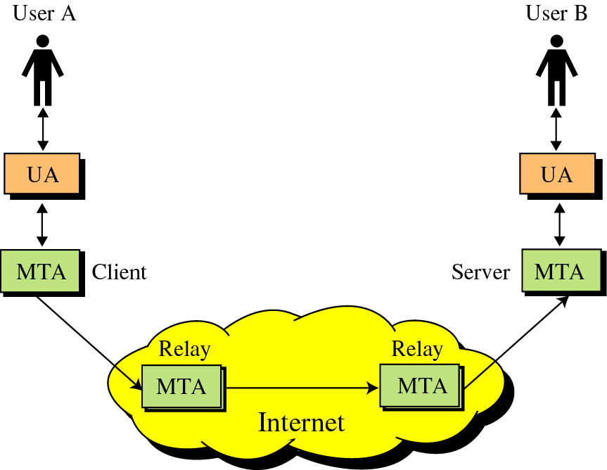
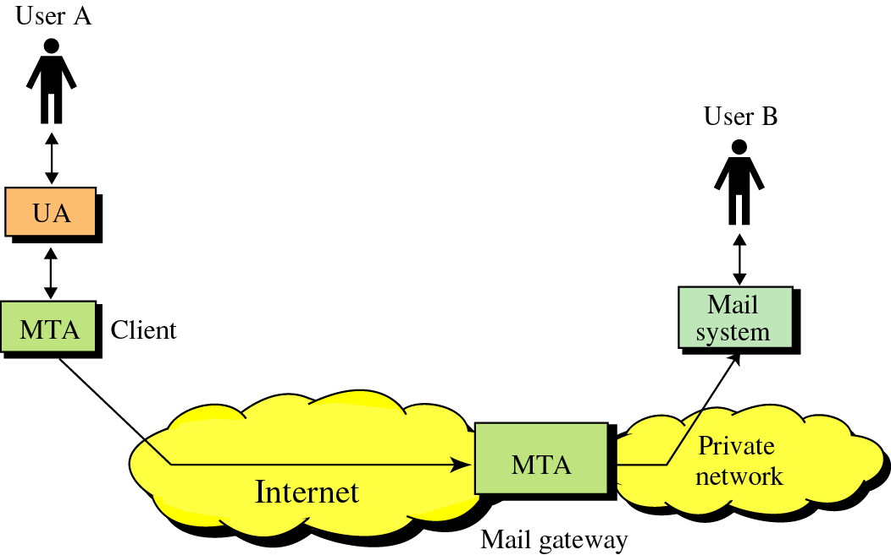
SMTP
SMTP also allows the use of Relays allowing other MTAs to relay the mail
Mail Gateways are used to relay mail prepared by a protocol other than SMTP and convert it to SMTP

Slide 152
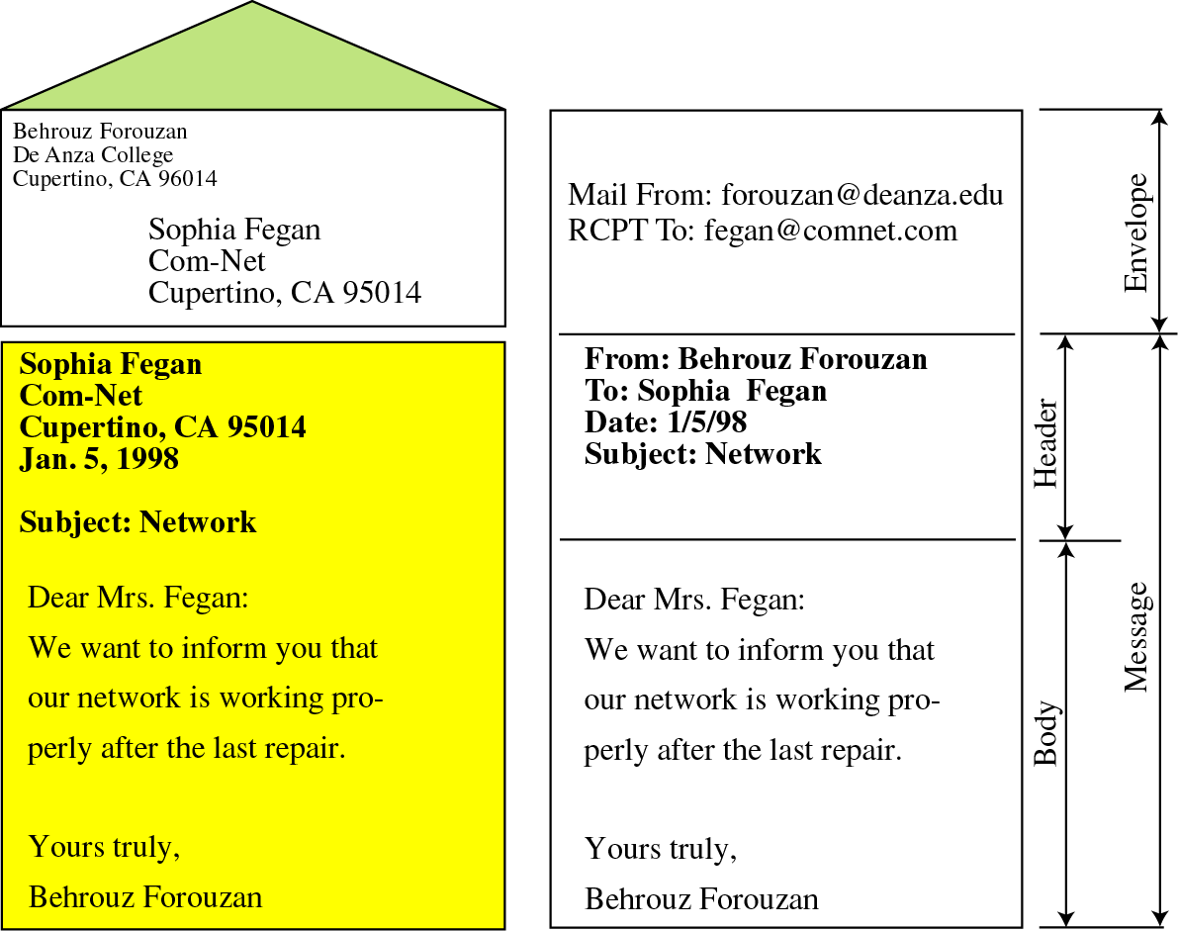
Format of an email
Mail is a text file
Envelope –
  sender address
  receiver address
  other information
Message –
  Mail Header – defines the sender, the receiver, the subject of the message, and other information
  Mail Body – Contains the actual information in the message

Slide 153
Post Office
Mailbox
From kissel@mail.acad.ece.udel.edu Tue Oct 25 20:27:21 2005
Return-Path: <kissel@mail.acad.ece.udel.edu>
X-Original-To: kissel@cis.udel.edu
Delivered-To: kissel@cis.udel.edu
Received: by mail.eecis.udel.edu (Postfix, from userid 62)
id 8EC8D18D; Tue, 25 Oct 2005 20:27:21 -0400 (EDT)
Received: from mail.acad.ece.udel.edu (devil-rays.acad.ece.udel.edu [128.4.60.10])
by mail.eecis.udel.edu (Postfix) with ESMTP id 59888C9
for <kissel@cis.udel.edu>; Tue, 25 Oct 2005 20:27:20 -0400 (EDT)
Received: by mail.acad.ece.udel.edu (Postfix, from userid 62)
id 344482045; Tue, 25 Oct 2005 20:27:20 -0400 (EDT)
Received: from nimbus.acad.ece.udel.edu (nimbus.acad.ece.udel.edu [128.4.63.34])
by mail.acad.ece.udel.edu (Postfix) with ESMTP id 3932E1ECA
for <kissel@cis.udel.edu>; Tue, 25 Oct 2005 20:27:19 -0400 (EDT)
Date: Tue, 25 Oct 2005 20:27:19 -0400 (EDT)
From: Ezra Kissel <kissel@mail.acad.ece.udel.edu>
X-X-Sender: kissel@nimbus.acad.ece.udel.edu
To: kissel@cis.udel.edu
Subject: email test
Message-ID: <Pine.LNX.4.62.0510252026550.4176@nimbus.acad.ece.udel.edu>
X-Sanitizer: This message has been sanitized!
X-Sanitizer-URL: http://mailtools.anomy.net/
X-Sanitizer-Rev: UDEL-ECECIS: Sanitizer.pm,v 1.64 2002/10/22 MIME-Version: 1.0
X-Spam-Checker-Version: SpamAssassin 3.0.4 (2005-06-05) on louie.udel.edu
X-Spam-Level:
X-Spam-Status: No, score=-3.8 required=4.1 tests=ALL_TRUSTED,BAYES_00
autolearn=ham version=3.0.4
X-Sanitizer: This message has been sanitized!
X-Sanitizer-URL: http://mailtools.anomy.net/
X-Sanitizer-Rev: UDEL-ECECIS: Sanitizer.pm,v 1.64 2002/10/22 MIME-Version: 1.0
MIME-Version: 1.0
Content-Type: TEXT/PLAIN; charset="US-ASCII"; format=flowed
Status: RO
X-Status:
X-Keywords:
X-UID: 50
This is a test message.
Post office
and mail route
Receiver’s
Mailbox

Slide 154
How SMTP works (A-PDU’s)
The Basics
Keyword | Arguments
HELO | Sender’s Host Domain Name
MAIL FROM: | Email Address of sender
RCPT TO: | Email of Intended recipient
DATA | Body of the message
QUIT

Slide 155
How SMTP works (A-PDU’s)
The Extras
Keyword | Arguments
RSET
VRFY | Name to be verified
NOOP
TURN
EXPN | Mailing list to expand
HELP | Command Name

Slide 156
Status Codes
The Server responds with a 3 digit code that may be followed by text info
  2## - Success
  3## - Command can be accepted with more information
  4## - Command was rejected, but error condition is temporary
  5## - Command rejected, Bad User!

Slide 157
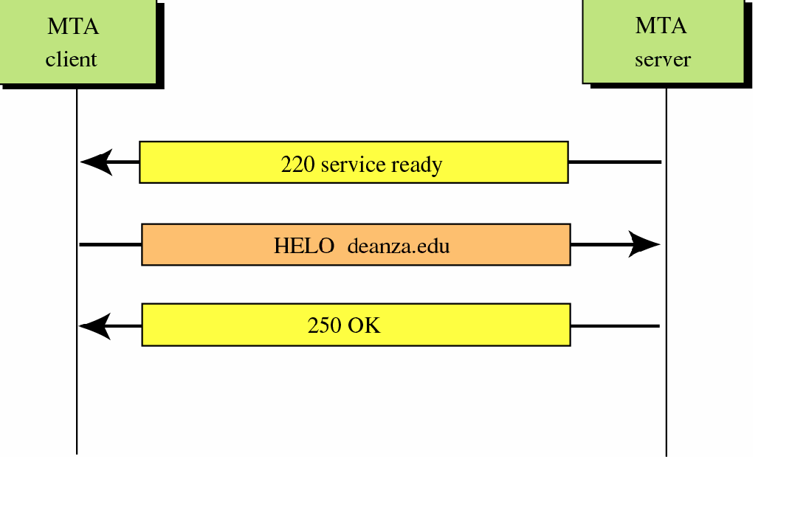
Connection Establishment
TCP Connection Establishment

Slide 158
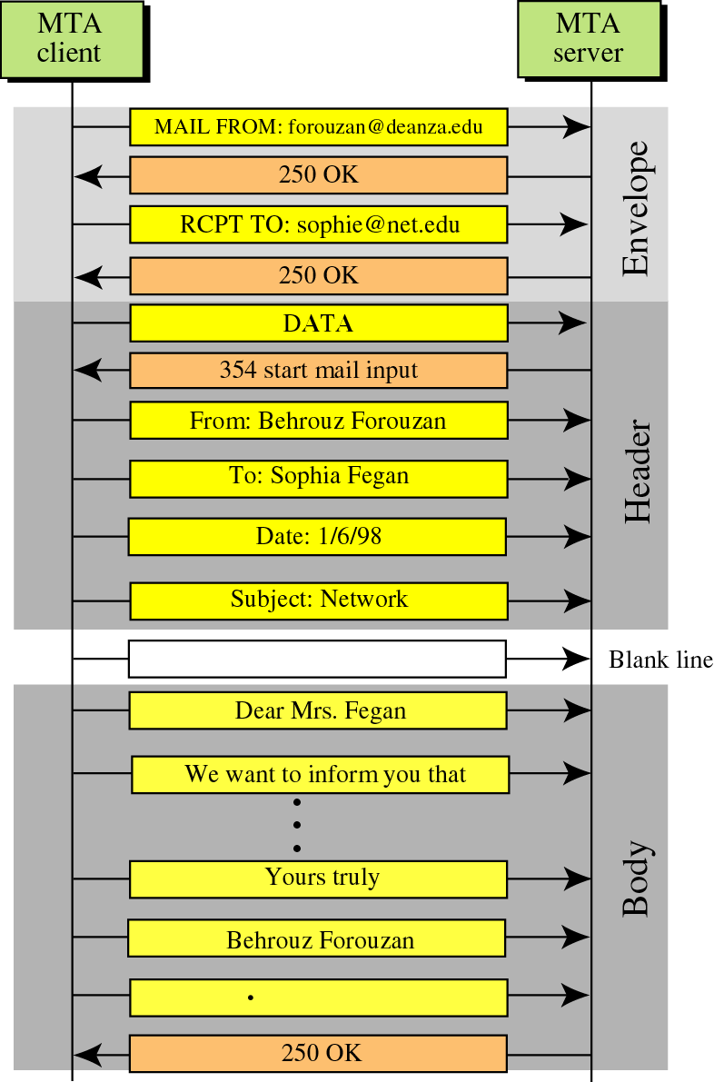
Message Progress

Slide 159
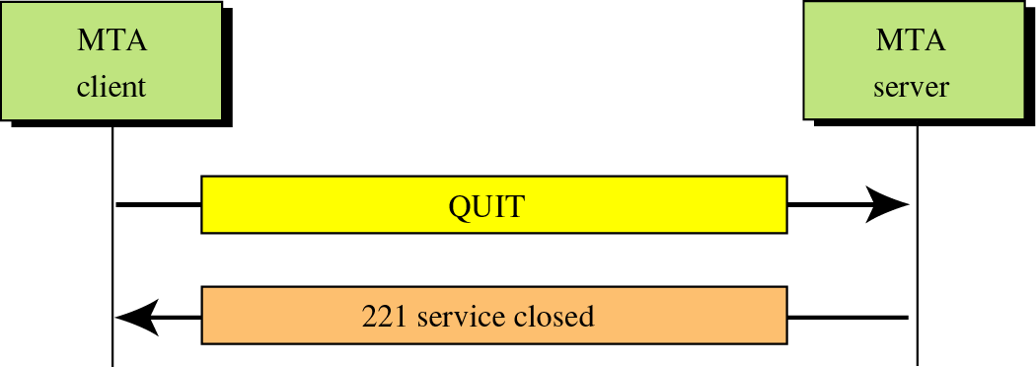
Connection Termination
TCP Connection Termination

Slide 160
Limitations in SMTP
Only uses NVT 7 bit ASCII format
  How to represent other data types?
No authentication mechanisms
Messages are sent un-encrypted
Susceptible to misuse (Spamming,
faking sender address)

Slide 161
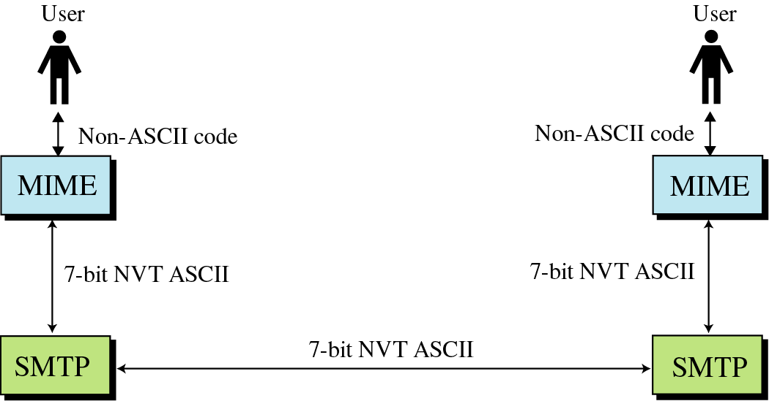
Solution: SMTP extensions
MIME – Multipurpose Internet Mail Extensions
  Transforms non-ASCII data to NVT (Network Virtual Terminal) ASCII data
    Text
    Application
    Image
    Audio
    Video
RFC 1425, 1426, 1521

Slide 162
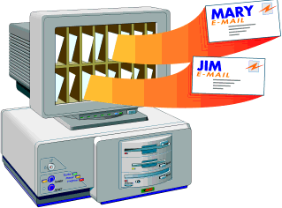
Email Systems

Slide 163
Overview
Email Basics
What Makes Up An Email
How Email Works
What Are TCP/IP Ports

Slide 164
Email Basics
What is an Email – an electronic message transmitted over a network from one user to another.
Can be as simple as a few lines of text, or include attachments such as pictures or documents.
Email made up 75% of network traffic soon after the introduction of the internet.

Slide 165
What Makes Up An Email
The Header
  Who sent the email.
  To whom the mail is sent.
  When the email was sent.
  The email subject.
  The size of the email.

Slide 166
What Makes Up An Email
The Body
  Contains the message.
  May also contain an attachment.
Attachments
  If not embedded within the body, attachments are sent along with the email.

Slide 167
How Email Works
Different Architectural Models exist for constructing computer systems.
Some models include:
  Peer-Peer
  Pipe and Filter
  Implicit Invocation
  Client-Server

Slide 168
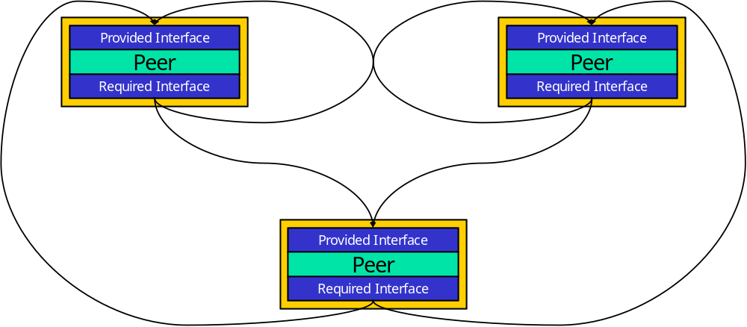
How Email Works
Peer-Peer Model

Slide 169
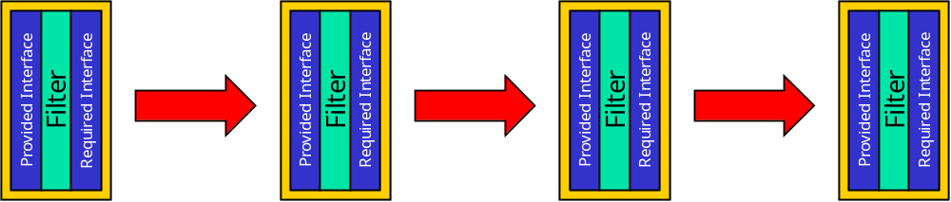
How Email Works
Pipe and Filter Model

Slide 170
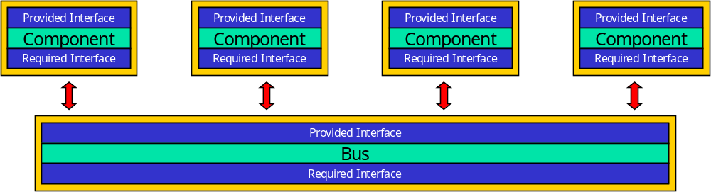
How Email Works
Implicit Invocation “Bus” Model

Slide 171
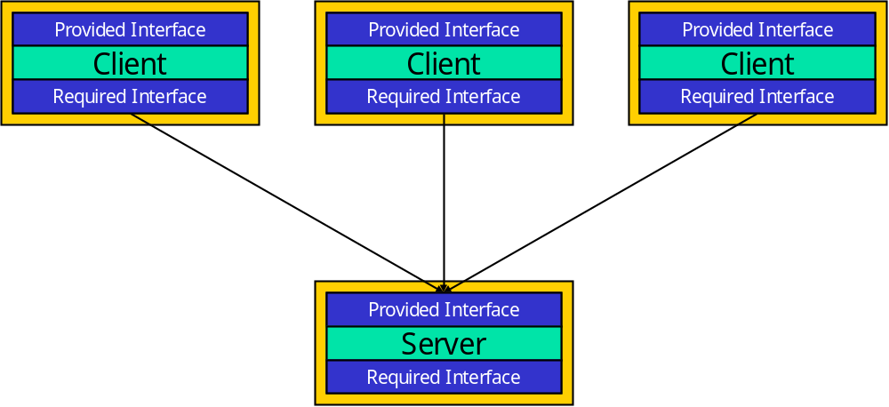
How Email Works
Client-Server Model

Slide 172
How Email Works
The model that works best for email is the Client-Server model.
Clients carry out user interactions with the email server.

Slide 173
How Email Works
Clients
Forms in which clients appear:
  Application based - these are installed onto user’s machines and include Microsoft Outlook and the freely available Outlook Express and Eudora.
  Web based - these appear in a web browser’s window and include Hotmail, Yahoo and Outlook web client.

Slide 174
How Email Works
Clients
Clients vary greatly in functionality, but all provide a basic level of functionality that assists the user.
Basic functions include:
  Ability to create new emails.
  Display and store received emails.
  Hold address lists of contacts, a calendar, journal and other extra functions that help organize the user’s working day.
  The client is also configured with the account information and names or IP addresses of the email servers with which it will be communicating.

Slide 175
How Email Works
Servers
An email server is typically a combination of processes running on a server with a large storage capacity – a list of users and rules, and the capability to receive, send and store emails and attachments.
These servers are designed to operate without constant user intervention.
Should process emails for months as sending, receiving and maintenance tasks are carried out at scheduled times. The client only has to connect to the email server when it sends and checks/receives new email.
Sometimes it may be permanently connected to the server to allow access to shared address books or calendar information – this is typical of a LAN-based email server.

Slide 176
How Email Works
Servers
Most email servers conduct email services by running two separate processes on the same machine.
One process is the POP3 (Post Office protocol 3) server, which holds emails in a queue and delivers emails to the client when they are requested.
The other is the SMTP (simple mail transfer protocol) server that receives outgoing emails from clients and sends and receives email from other SMTP servers.
These two processes are linked by an internal mail delivery mechanism that moves mail between the POP3 and SMTP servers.

Slide 177
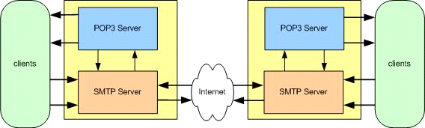
How Email Works
Servers
When the client calls the email server to send or check for mail it connects to the server on certain TCP/IP ports:
  SMTP on port 25
  POP3 on port 110.

Slide 178
How Email Works
Servers
Email systems come in various formats, but the most common rely on a single server that provides both POP3 and SMTP services.
Sometimes, in large organizations, these services are separated onto different servers.
Currently, the majority of email servers use Windows NT or 2000.

Slide 179
What Are TCP/IP Ports
Most email servers run on a web server platform with email services installed.
Each server has one or more unique TCP/IP (transmission control protocol/internet protocol) addresses. Attached to all TCP/IP addresses are many ports that range from 0 to 65,535.
TCP/IP uses ports to allocate different jobs to different services. The server will listen for a client or application to call it on a port and direct traffic from that port to the required service.

Slide 180
MIME Headers
Located between the Email Header and Body
  MIME-Version: 1.1
  Content-Type: type/subtype
  Content-Transfer-Encoding: encoding type
  Content-Id: message id
  Content-Description: textual explanation of non-textual contents

Slide 181
MIME Headers (cont’d)
Content-Type – Type of data used in the Body
  Text: plain, unformatted text; HTML
  Multipart: Body contains different data types
  Message: Body contains a whole, part, or pointer to a message
  Image: Message contains a static image (JPEG, GIF)
  Video: Message contains an animated image (MPEG)
  Audio: Message contains a basic sound sample (8kHz)
  Application: Message is of data type not previously defined
Content-Transfer-Encoding – How to encode the message
  7 bit – no encoding needed
  8 bit – Non-ASCII, short lines
  Binary – Non-ASCII, unlimited length lines
  Base64 – 6 bit blocks encoded into 8-bit ASCII
  Quoted-printable – send non-ASCII characters as 3 ASCII characters, =##, ## is the hex representation of the byte

Slide 182
Base64 Encoding
Divides binary data into 24 bit blocks
Each block is then divided into 6 bit chunks
Each 6-bit section is interpreted as one character, 25% overhead
11001100 10000001 00111001
110011 001000 000100 111001
(51)
(8)
(4)
(57)
(z)
(I)
(E)
(5)
01111010
01001001
01000101
00110101

Slide 183
Quoted-Printable Encoding
Used when the data has a small non-ASCII portion
Non-ASCII characters are sent as 3 characters
First is ‘=‘, second and third are the hex representation of the byte
01001100 10011101 00111001
(=)
(9)
(D)
00111101
00111001
01000100

Slide 184
Multipart, Encoded MIME Message
From: Ezra Kissel <kissel@mail.acad.ece.udel.edu>
To: kissel@cis.udel.edu
Subject: attachment test
MIME-Version: 1.0
Content-Type: MULTIPART/MIXED; boundary="MIMEStream=_0+92061_793033260215529_597673089"
--MIMEStream=_0+92061_793033260215529_597673089
Content-Type: TEXT/PLAIN; charset="US-ASCII"; format=flowed
There is an image attached...
--MIMEStream=_0+92061_793033260215529_597673089
Content-Type: IMAGE/jpeg; name="test.jpg"
Content-Transfer-Encoding: base64
Content-Disposition: attachment; filename="test.jpg"
/9j/4AAQSkZJRgABAgEASABIAAD/4QNxRXhpZgAATU0AKgAAAAgABwESAAMA
AAABAAEAAAEaAAUAAAABAAAAYgEbAAUAAAABAAAAagEoAAMAAAABAAIAAAEx
…
osv/0I5nPvr7sVdirsVf/9GO5z76+6hxQ1il2Kv/0o5nPvr7eKtYq7FX/9k=
--MIMEStream=_0+92061_793033260215529_597673089--

Slide 185
SMTP AUTH
MTA Client
MTA Server
TCP Connection Establishment
Allows the server to provide features only to known users and limit others.
Various authentication methods may be used (PLAIN, LOGIN, CRAM-MD5, etc.)
Encryption is highly recommended if not enforced by MTA.
Ex. AUTH PLAIN
  Simple
  Usage: AUTH PLAIN <id>\0<user>\0<password>
  Authentication string is Base64 encoded
220 Service Ready
EHLO stimpy.cis.udel.edu
250 Hello stimpy.cis.udel.edu
Negotiate Encryption (STARTTLS)
AUTH PLAIN AGV6cmEAYg==
235 Authentication Succeeded
MAIL FROM: kissel@cis.udel.edu
250 OK
RCPT TO: amer@cis.udel.edu
250 OK
RFC 1869, 2554, 2595

Slide 186
Email can be faked…
HELO stimpy.eecis.udel.edu
MAIL FROM: cis-dept@cis.udel.edu
RCPT TO: amer@cis.udel.edu
DATA
From: Department Chair
To: Dr. Paul Amer
Subject: CISC856
Dr. Amer,
By department decree all students in your CISC856 TCP/IP class are hereby to be given automatic A’s.
Thank you,
Department Chair
.
QUIT
Solutions
Email signatures (PGP)
Sender Policy Framework (SPF)

Slide 187
MTAs and Mail Access Protocols
The MTA delivers email to the user’s mailbox
Can be complex with numerous delivery methods, routers, and ACLs
Exim, Postfix, Sendmail
The Mail Access Protocols are used by the users to retrieve the email from the mailbox
  POP3
  IMAP4

Slide 188
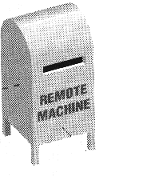


POP vs. IMAP
POP3:
All Messages
Internet
Whole message
IMAP:
Dr.Amer
Friends
….
headers
Internet

Slide 189
Post Office Protocol v3
Simple
Allows the user to obtain a list of their Emails
Users can retrieve their emails
Users can either delete or keep the email on their system
Minimizes server resources
Notes:
http://www.washington.edu/computing/windows/issue13/imap_pop.html

Slide 190
Internet Mail Access Protocol v4
Has more features than POP3
User can check the email header before downloading
Emails can be accessed from any location
Can search the email for a specific string of characters before downloading
User can download parts of an email
User can create, delete, or rename mailboxes on a server

Slide 191
Multipurpose Internet Mail Extensions
(MIME)

Slide 192
MIME
Important RFCs
  RFC-822 Standard for the format for ARPA Internet test messages
  RFC-2045 MIME Part 1: Format of Internet Message Bodies
  RFC-2046 MIME Part 2: Media Types
  RFC-2047 MIME Part 3: Message Header Extensions
  RFC-2048 MIME Part 4: Registration Procedure
  RFC-2049 MIME Part 5: Conformance Criteria

Slide 193
MIME – What is it?
MIME refers to an official Internet standard that specifies how messages must be formatted so that they can be exchanged between different email systems.
MIME permits the inclusion of virtually any type of file or document in an email message.
Specifically, MIME messages can contain
  text
  images
  audio
  video
  application-specific data.
    spreadsheets
    word processing documets

Slide 194
MIME Features
Support of character sets other than ASCII
Content type labeling System
Support of non-text content in e-mail messages
Support for compound documents

Slide 195
Non-ASCII Character set support
Message header
  content-type field
    put in the header by the client program creating the e-mail for use by the client program used to display the received message
    charset= optional parameter
      if absent ASCII is assumed
Content-Type: text/plain; charset="ISO-8859-1"
  ISO-8859-1 extends the basic character set of ASCII to include many of the accented characters used in languages such as Spanish, French, and German.
  US-ASCII is the standard character set used in the US

Slide 196
Content Labeling
a set of registered MIME Types that map to specific file types
  MIME Types consist of :
    a primary type
    a sub type separated by a / ( as text/html)
Common Mime Types:
FileExtension MIME Type Description
.txt text/plain Plain text
.htm text/html Styled text in HTML format
.jpg image/jpeg Picture in JPEG format
.gif image/gif Picture in GIF format
.wav audio/x-wave Sound in WAVE format
.mp3 audio/mpeg Music in MP3 format
.mpg video/mpeg Video in MPEG format
.zip application/zip Compressed file in PK-ZIP format

Slide 197
Non-text Content
To be sent through the e-mail system non-textual content must be converted (encoded) to ASCII for transmission and unencode back to its original format for display upon receipt.
  originally done via uuencode
  MIME uses base 64 encoding (RFC 2045)
    binary to text encoding scheme
    targets A-Z, a-z,0-9, +,/
    scheme:
      take three byte of data, put into a 24 bit buffer
      extract 4 six bit values
      use each value as an index into:
        ABCDEFGHIJKLMNOPQRSTUVWXYZabcdefghijklmnopqrstuvwxyz0123456789+/
      this yields 4 ASCII characters

Slide 198
base64 encoding example
Man is distinguished, not only by his reason, but by this singular passion from other animals, which is a lust of the mind, that by a perseverance of delight in the continued and indefatigable generation of knowledge, exceeds the short vehemence of any carnal pleasure.
base64 encoded:
TWFuIGlzIGRpc3Rpbmd1aXNoZWQsIG5vdCBvbmx5IGJ5IGhpcyByZWFzb24sIGJ1dCBieSB0 aGlzIHNpbmd1bGFyIHBhc3Npb24gZnJvbSBvdGhlciBhbmltYWxzLCB3aGljaCBpcyBhIGx1 c3Qgb2YgdGhlIG1pbmQsIHRoYXQgYnkgYSBwZXJzZXZlcmFuY2Ugb2YgZGVsaWdodCBpbiB0 aGUgY29udGludWVkIGFuZCBpbmRlZmF0aWdhYmxlIGdlbmVyYXRpb24gb2Yga25vd2xlZGdl LCBleGNlZWRzIHRoZSBzaG9ydCB2ZWhlbWVuY2Ugb2YgYW55IGNhcm5hbCBwbGVhc3VyZS4=

Slide 199
Multipart Messages
use content-type = multipart/sub type
  sub types :
    related
    mixed
see examples at http://www.hunnysoft.com/mime/samples/index.htm

Slide 200
SNMP
Simple Network Management Protocol

Slide 201
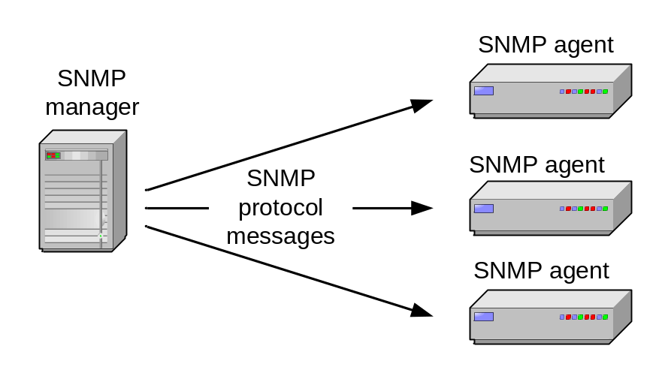
Simple Network Management Protocol
SNMP is a framework that provides facilities for managing and monitoring network resources on the Internet.
Components of SNMP:
  SNMP agents
  SNMP managers
  Management Information Bases (MIBs)
  SNMP protocol itself

Slide 202
Simple Network Management Protocol
SNMP agent is software that runs on a piece of network equipment (host, router, printer, or others) and that maintains information about its configuration and current state in a database
Information in the database is described by Management Information Bases (MIBs)
An SNMP manager is an application program that contacts an SNMP agent to query or modify the database at the agent.
SNMP protocol is the application layer protocol used by SNMP agents and managers to send and receive data.

Slide 203
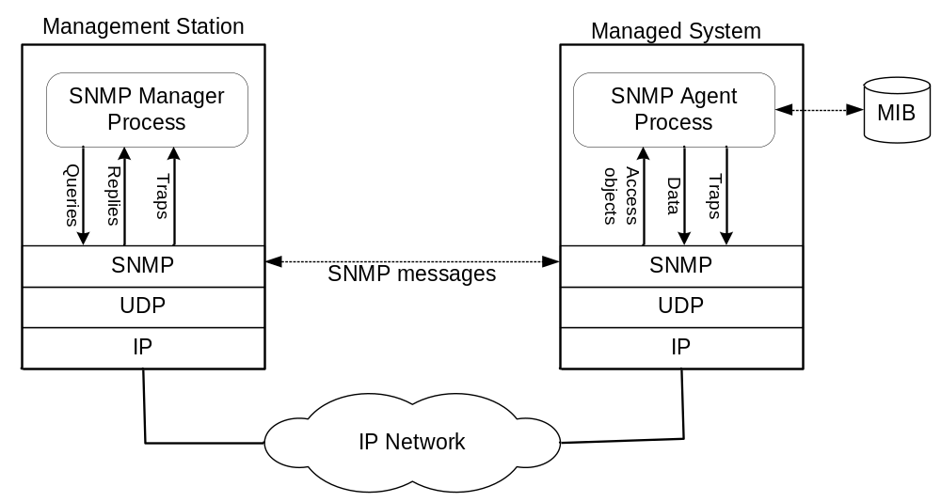
SNMP
Interactions in SNMP

Slide 204
MIBS
A MIB specifies the managed objects
MIB is a text file that describes managed objects using the syntax of ASN.1 (Abstract Syntax Notation 1)
ASN.1 is a formal language for describing data and its properties
In Linux, MIB files are in the directory /usr/share/snmp/mibs
  Multiple MIB files
  MIB-II (defined in RFC 1213) defines the managed objects of TCP/IP networks

Slide 205
Managed Objects
Each managed object is assigned an object identifier (OID)
The OID is specified in a MIB file.
An OID can be represented as a sequence of integers separated by decimal points or by a text string:
Example:
  1.3.6.1.2.1.4.6.
  iso.org.dod.internet.mgmt.mib-2.ip.ipForwDatagrams
When an SNMP manager requests an object, it sends the OID to the SNMP agent.

Slide 206
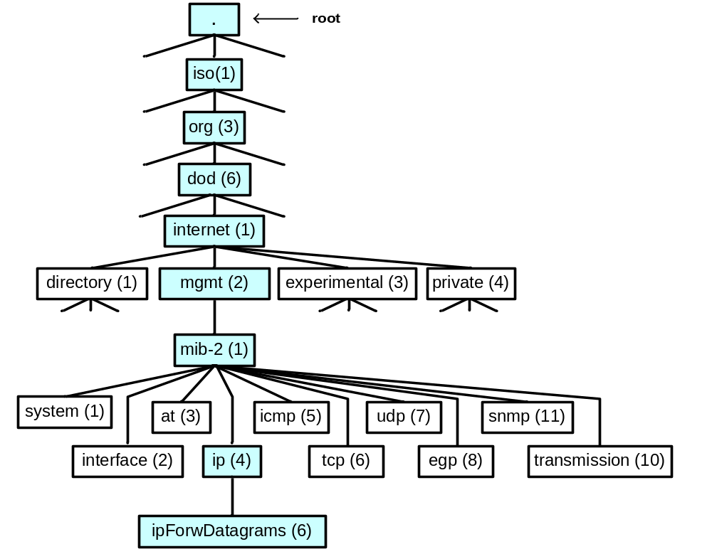
Organization of managed objects
Managed objects are organized in a tree-like hierarchy and the OIDs reflect the structure of the hierarchy.
Each OID represents a node in the tree.
The OID 1.3.6.1.2.1 (iso.org.dod.internet.mgmt.mib-2) is at the top of the hierarchy for all managed objects of the MIB-II.
Manufacturers of networking equipment can add product specific objects to the hierarchy.

Slide 207
Definition of managed objects in a MIB
Specification of ipForwDatagrams in MIB-II.
ipForwDatagrams OBJECT-TYPE
SYNTAX Counter
ACCESS read-only
STATUS mandatory
DESCRIPTION
"The number of input datagrams for which this
entity was not their final IP destination, as a
result of which an attempt was made to find a
route to forward them to that final destination.
In entities which do not act as IP Gateways, this
counter will include only those packets which were
Source-Routed via this entity, and the Source-
Route option processing was successful."
::= { ip 6 }

Slide 208
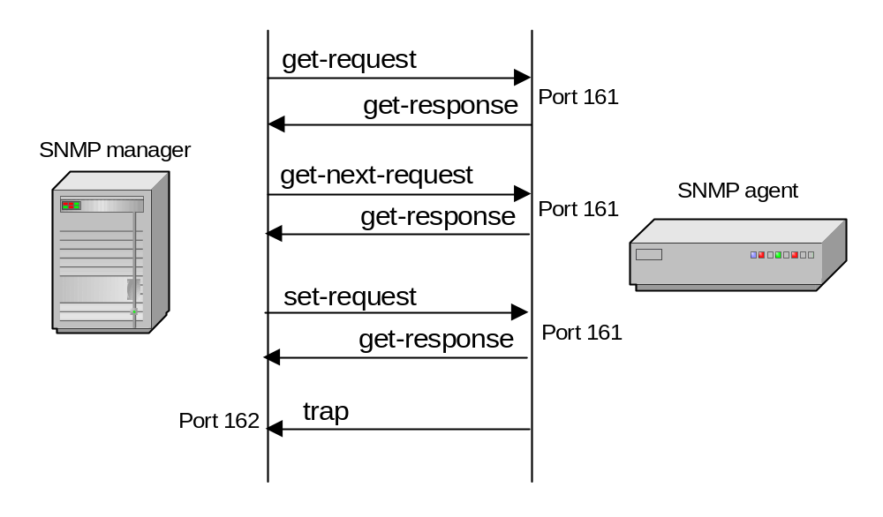
SNMP Protocol
SNMP manager and an SNMP agent communicate using the SNMP protocol
  Generally: Manager sends queries and agent responds
  Exception: Traps are initiated by agent.

Slide 209
SNMP Protocol
Get-request. Requests the values of one or more objects
Get-next-request. Requests the value of the next object, according to a lexicographical ordering of OIDs.
Set-request. A request to modify the value of one or more objects
Get-response. Sent by SNMP agent in response to a get-request, get-next-request, or set-request message.
Trap. An SNMP trap is a notification sent by an SNMP agent to an SNMP manager, which is triggered by certain events at the agent.

Slide 210
Traps
Traps are messages that asynchronously sent by an agent to a manager
Traps are triggered by an event
Defined traps include:
  linkDown: Even that an interface went donw
  coldStart - unexpected restart (i.e., system crash)
  warmStart - soft reboot
  linkUp - the opposite of linkDown
  (SNMP) AuthenticationFailure
  …

Slide 211
SNMP Versions
Three versions are in use today:
  SNMPv1 (1990)
  SNMPv2c (1996)
    Adds “GetBulk” function and some new types
    Adds RMON (remote monitoring) capability
  SNMPv3 (2002)
    SNMPv3 started from SNMPv1 (and not SNMPv2c)
    Addresses security
All versions are still used today
Many SNMP agents and managers support all three versions of the protocol.

Slide 212
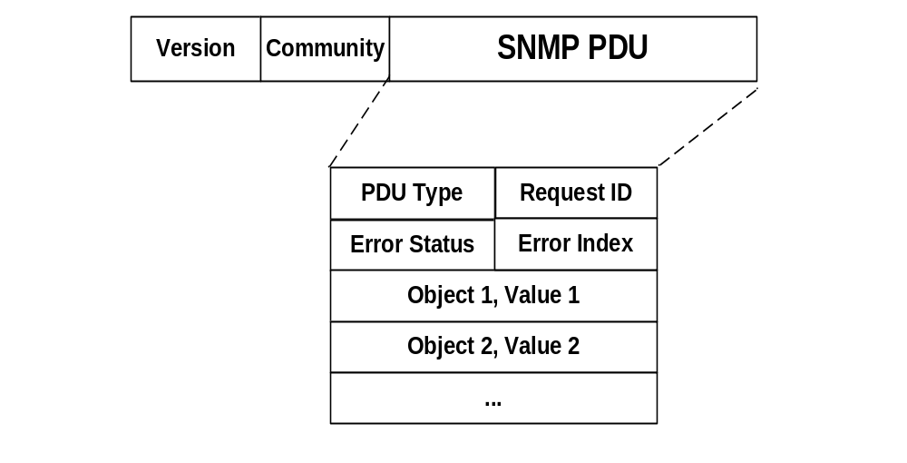
Format of SNMP Packets
SNMPv1 Get/Set messages:
Cleartext string that is used as a password
PDU type, e.g.:
32: SNMPv1 Get
64: SNMPv2 Get
Unique ID to match requests with replies
Sequence of name-value pairs

Slide 213
SNMP Security
SNMPv1 uses plain text community strings for authentication as plain text without encryption
SNMPv2 was supposed to fix security problems, but effort de-railed (The “c” in SNMPv2c stands for “community”).
SNMPv3 has numerous security features:
  Ensure that a packet has not been tampered with (integrity),
  Ensures that a message is from a valid source (authentication)
  Ensures that a message cannot be read by unauthorized (privacy).

Slide 214
SNMP Security
Security model of SNMPv3 has two components:
  1.Instead of granting access rights to a community, SNMPv3 grants access to users.
  2. Access can be restricted to sections of the MIB (Version-based Access Control Module (VACM). Access rights can be limited
    by specifying a range of valid IP addresses for a user or community,
    or by specifying the part of the MIB tree that can be accessed.

Slide 215
Security levels in SNMPv2
SNMP has three security levels:
noAuthNoPriv: Authentication with matching a user name.
authNoPriv: Authentication with MD5 or SHA message digests.
authPriv: Authentication with MD5 or SHA message digests, and encryption with DES encryption
Compare this to SNMPv1 and SNMPv2c:
SNMPv1, SNMPv2: Authentication with matching a community string.

